Slide 1
Material Science Module I

Slide 2
Historical Perspective
The material possessions of our earliest ancestors were probably their tools and weapons.
In fact, the most popular way of naming the era of early human civilization is in terms of the materials from which these tools and weapons were made.
The Stone Age has been traced as far back as 2.5 million years ago when human ancestors, or hominids, chipped stones to form weapons for hunting.

Slide 3
The Bronze Age roughly spanned the period from 2000 B.C. to 1000 B.C. and represents the foundation of metallurgy, in which alloys of copper and tin were discovered to produce superior tools and weapons.
Copper Age existed between roughly 4000 B.C. to 3000 B.C. in Europe, in which relatively pure copper was used before tin became available.
The Iron Age defines the period from 1000 B.C. to 1 B.C.

Slide 4
By 500 B.C., iron alloys had largely replaced bronze for tool and weapon making in Europe.
Although archaeologists do not refer to a “pottery age,” the presence of domestic vessels made from baked clay has provided some of the best descriptions of human cultures for thousands of years.

Slide 5
Importance of Materials
Why do we study materials?
Many engineers, whether mechanical, computer, civil, chemical, or electrical, at one time or another are exposed to a design problem involving materials, such as a transmission gear, the superstructure for a building, an oil refinery component, or an integrated circuit chip.

Slide 6
Many times, a materials problem is one of selecting the right material from the thousands available.
The final decision is normally based on several criteria.
First, the in-service conditions must be characterized, for these dictate the properties required of the material.
On only rare occasions does a material possess the maximum or ideal combination of properties. Thus, it may be necessary to trade one characteristic for another.

Slide 7
A second selection consideration is any deterioration of material properties that may occur during service operation.
For example, significant reductions in mechanical strength may result from exposure to elevated temperatures or corrosive environments.
Finally, probably the overriding consideration is that of economics: What will the finished product cost? A material may be found that has the ideal set of properties but is prohibitively expensive.

Slide 8
The more familiar an engineer or scientist is with the various characteristics and structure–property relationships, as well as the processing techniques of materials, the more proficient and confident he or she will be in making judicious materials choices based on these criteria.
Liberty ship S.S. Schenectady, which, in 1943, failed before leaving the shipyard

Slide 9
Fundamentals of crystal structure
Solid materials may be classified according to the regularity with which atoms or ions are arranged with respect to one another.
A crystalline material is one in which the atoms are situated in a repeating or periodic array over large atomic distances.
All metals, many ceramic materials, and certain polymers form crystalline structures under normal solidification conditions.
For those that do not crystallize, this long-range atomic order is absent; these are called non-crystalline or amorphous materials.

Slide 10
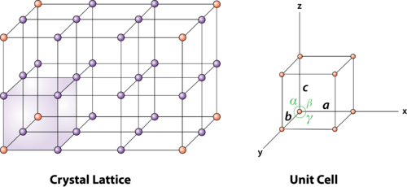
Crystal lattice
The crystal lattice is the symmetrical three-dimensional structural arrangements of atoms, ions or molecules (constituent particle) inside a crystalline solid as points.
It can be defined as the geometrical arrangement of the atoms, ions or molecules of the crystalline solid as points in space.

Slide 11
Unit Cell
A unit cell is the smallest portion of a crystal lattice that shows the three-dimensional pattern of the entire crystal.
A crystal can be thought of as the same unit cell repeated over and over in three dimensions.

Slide 12
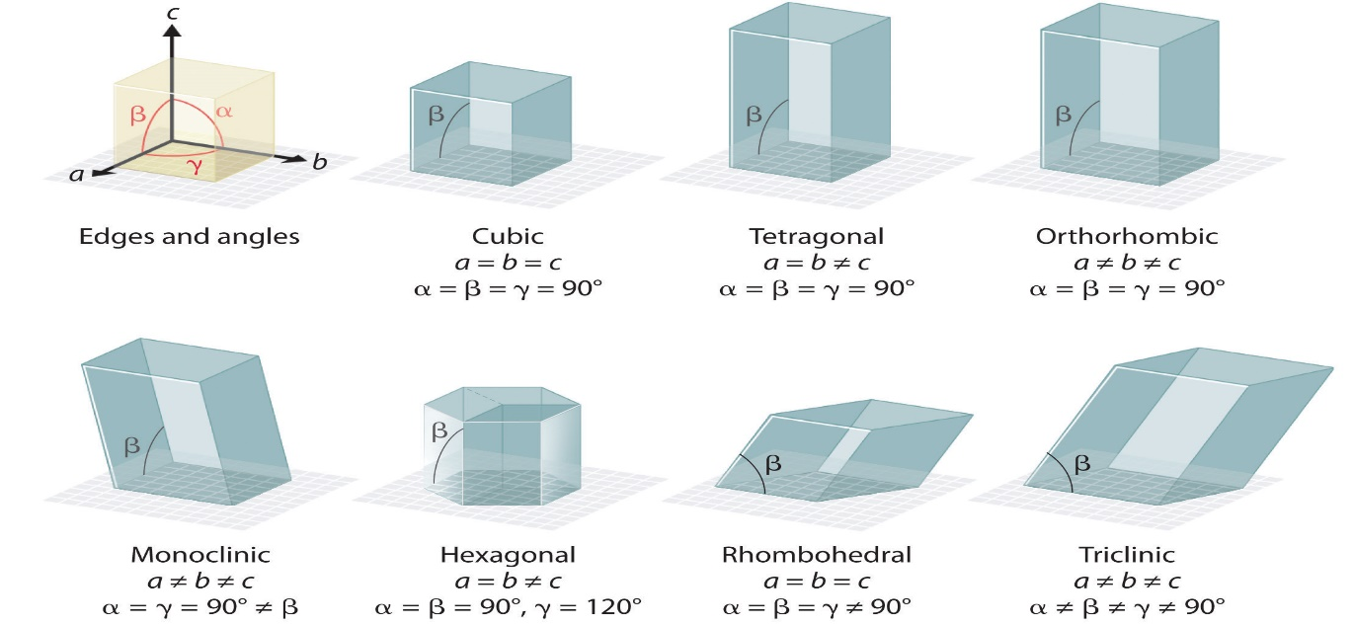
Crystal Systems

Slide 13
Simple Cubic Unit Cell
In the simple or primitive cubic unit cell, the atoms are present only at the corners.
Every atom at the corner is shared among 8 adjacent unit cells. There are 4 unit cells in the same layer and 4 in the upper (or lower) layer.
Therefore, a particular unit cell has the only 1/8th of an atom.

Slide 14
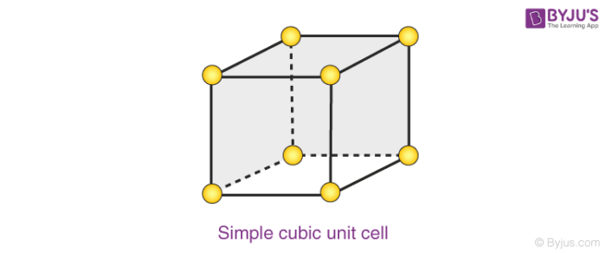
Each small sphere in the following figure represents the centre of a particle that occupies that particular position and not its size. This structure is known as an open structure.
In each cubic unit cell, there are 8 atoms at the corners. Therefore, the total number of atoms in one unit cell is 8 × 1/8 = 1 atom.

Slide 15
Metallic crystal structures
Three relatively simple crystal structures are found for most of the common metals:
face-centered cubic,
body centered cubic, and
hexagonal close-packed.

Slide 16
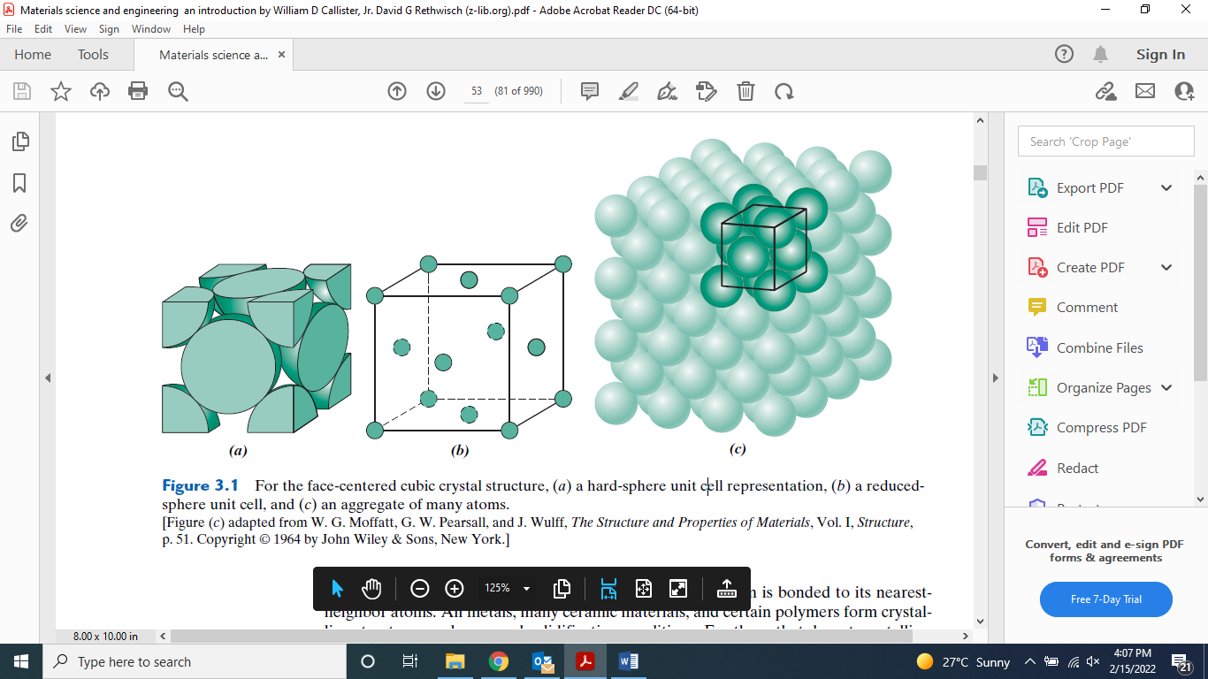
The Face-Centered Cubic Crystal Structure
The crystal structure found for many metals has a unit cell of cubic geometry, with atoms located at each of the corners and the centers of all the cube faces.
It is aptly called the face-centered cubic (FCC) crystal structure. Some of the familiar metals having this crystal structure are copper, aluminum, silver, and gold.

Slide 17

Number of atoms in a unit cell
For cubic unit cells, an atom completely within the interior “belongs” to that unit cell, one at a cell face is shared with one other cell, and an atom residing at a corner is shared among eight.
The number of atoms per unit cell, N, can be computed using the following formula:
$N=N_{i}+\frac{N_{f}}{2}+\frac{N_{C}}{8}$
Where N_{i} are number of interior atoms, N_{f} are number of face atoms and N_{c} are number of corner atoms.

Slide 18

Number of atoms in FCC unit cell
For the FCC crystal structure, there are eight corner atoms (N_{c} = 8), six face atoms (N_{f} = 6), and no interior atoms (N_{i} = 0). Thus, from above Equation
$$N=0+\frac{6}{2}+\frac{8}{8}=4$$
or a total of four whole atoms may be assigned to a given unit cell. This is depicted in Figure, where only sphere portions are represented within the confines of the cube.

Slide 19
Coordination Number
Coordination Number is defined as number of nearest-neighbor or touching atoms.
For face-centered cubic, the coordination number is 12.
the front face atom has four corner nearest-neighbor atoms surrounding it, four face atoms that are in contact from behind, and four other equivalent face atoms residing in the next unit cell to the front (not shown).

Slide 20
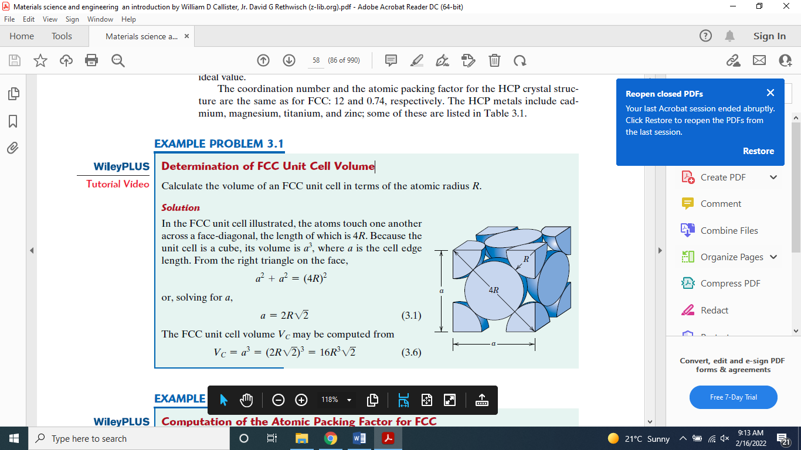
Determination of FCC atomic radius Unit Cell Volume
In the FCC unit cell illustrated, the atoms touch one another across a face-diagonal, the length of which is 4R.

Slide 21

Because the unit cell is a cube, its volume is a³, where a is the cell edge length. From the right triangle on the face,
$a^{2}+a^{2}={(4R)}^{2}$
or, solving for a,
$a=R\sqrt{2}$
The FCC unit cell volume V_{C} may be computed from
$V_{C}=a^{3}={(2R\sqrt{2})}^{3}={16R}^{3}\sqrt{2}$

Slide 22

Atomic Packing Factor for FCC
The APF is defined as the fraction of solid sphere volume in a unit cell, or
$Atomic Packing Factor=\frac{volume of atoms in a unit cell}{total unit cell volume}=\frac{V_{S}}{V_{C}}$
Both the total atom and unit cell volumes may be calculated in terms of the atomic radius R.

Slide 23

The volume for a sphere is $4/3{πR}^{3}$and because there are four atoms per FCC unit cell, the total FCC atom (or sphere) volume is
$$V_{S}=\left(4\right)\frac{4}{3}{πR}^{3}=\frac{16}{3}{πR}^{3}$$
Therefore, the atomic packing factor is
$$APF=\frac{V_{S}}{V_{C}}=\frac{\frac{16}{3}{πR}^{3}}{{16R}^{3}\sqrt{2}}=0.74$$

Slide 24
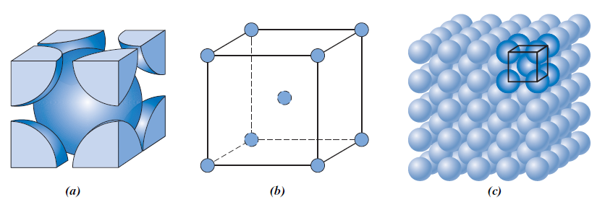
The Body-Centered Cubic Crystal Structure
Another common metallic crystal structure also has a cubic unit cell with atoms located at all eight corners and a single atom at the cube center.
This is called a body-centered cubic (BCC) crystal structure.

Slide 25

Each BCC unit cell has eight corner atoms and a single center atom, which is wholly contained within its cell; therefore, the number of atoms per BCC unit cell is
$$N=N_{i}+\frac{N_{f}}{2}+\frac{N_{C}}{8}$$
$$N=1+0+\frac{8}{8}=2$$
The coordination number for the BCC crystal structure is 8; each center atom has as nearest neighbors its eight corner atoms.

Slide 26
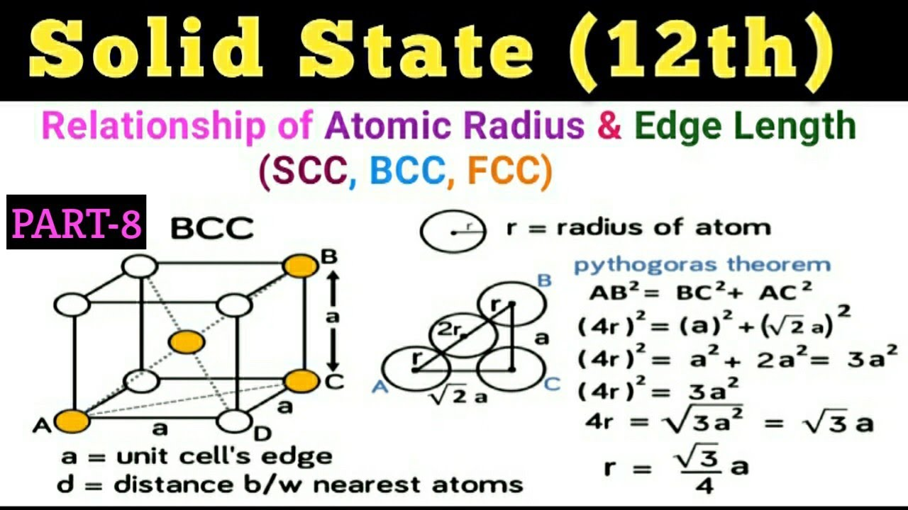

Determination of BCC atomic radius Unit Cell Volume
${AB}^{2}={BC}^{2}+{AC}^{2}$
$${(4R)}^{2}={(a)}^{2}+{(\sqrt{2}a)}^{2}$$

Slide 27

$${(4R)}^{2}=a^{2}+{2a}^{2}=3a^{2}$$
$${(4R)}^{2}=3a^{2}$$
$$4R=\sqrt{3a^{2}}=\sqrt{3}a$$
$$R=\frac{\sqrt{3}}{4}a$$
The BCC unit cell volume V_{C} may be computed from
$$V_{C}=a^{3}={\left(\frac{4}{\sqrt{3}}R\right)}^{3}$$

Slide 28

Atomic Packing Factor for BCC
The number of atoms per BCC unit cell are 2, therefore, the atomic packing factor is
$$APF=\frac{V_{S}}{V_{C}}$$
$$=\frac{\left(2\right)\frac{4}{3}{πR}^{3}}{{\left(\frac{4}{\sqrt{3}}R\right)}^{3}}=0.68$$

Slide 29
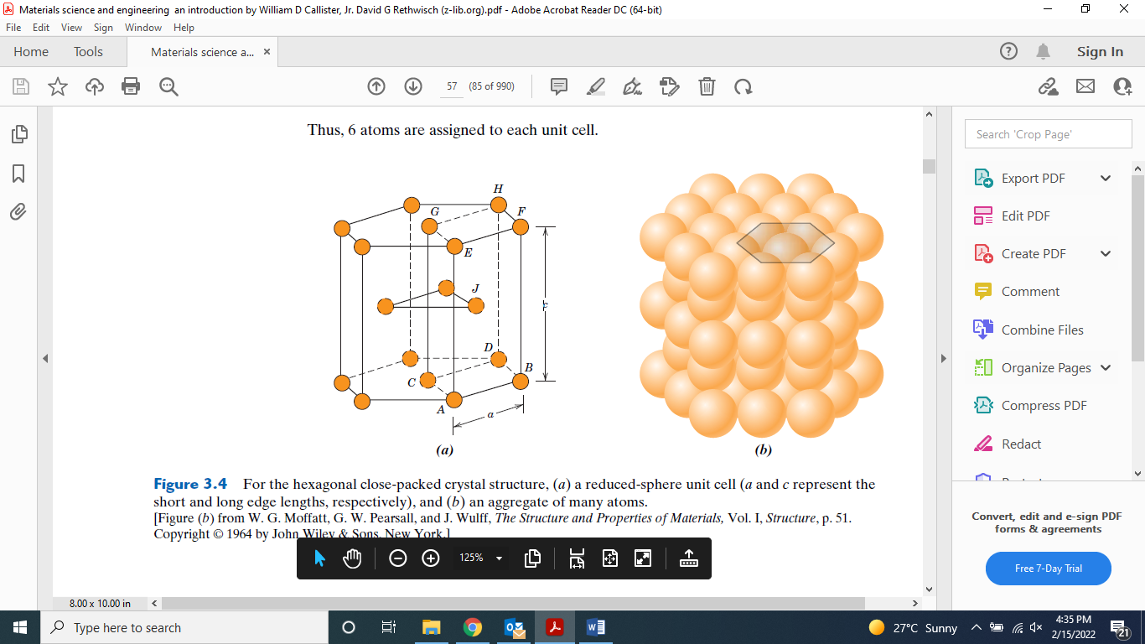
The Hexagonal Close-Packed Crystal Structure
Not all metals have unit cells with cubic symmetry; the final common metallic crystal structure to be discussed has a unit cell that is hexagonal and termed hexagonal close-packed (HCP).

Slide 30
The top and bottom faces of the unit cell consist of six atoms that form regular hexagons and surround a single atom in the center.
Another plane that provides three additional atoms to the unit cell is situated between the top and bottom planes.
The atoms in this midplane have as nearest neighbors atoms in both of the adjacent two planes.

Slide 31
If a and c represent, respectively, the short and long unit cell dimensions of Figure, the c/a ratio should be 1.633
However, for some HCP metals, this ratio deviates from the ideal value.

Slide 32

Number of atoms in HCP
In order to compute the number of atoms per unit cell for the HCP crystal structure, prev Equation is modified to read as follows:
$N=N_{i}+\frac{N_{f}}{2}+\frac{N_{C}}{6}$
That is, one-sixth of each corner atom is assigned to a unit cell (instead of 8 as with the cubic structure).

Slide 33

Because for HCP there are
6 corner atoms in each of the top and bottom faces (for a total of 12 corner atoms),
2 face center atoms (one from each of the top and bottom faces), and
3 midplane interior atoms,
the value of N for HCP is found to be
$$N=3+\frac{2}{2}+\frac{12}{6}=6$$
Thus, 6 atoms are assigned to each unit cell.

Slide 34
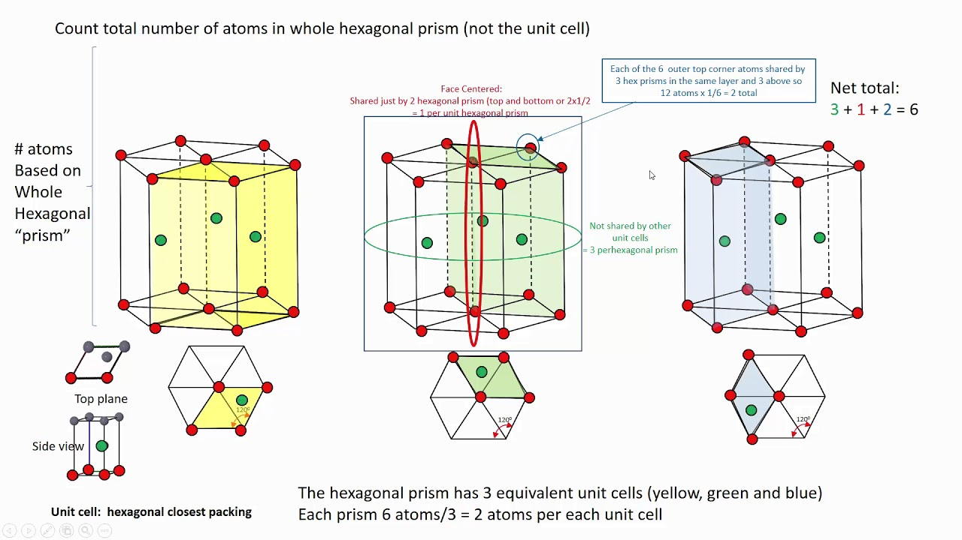
The hexagonal prism has 3 equivalent unit cells (yellow, green and blue). Each prism 6 atoms/3 = 2 atoms per unit cell

Slide 35

Volume of HCP Unit Cell
Volume of unit cell = Area of base × Height of the unit cell
The base of (HCP)is a hexagon. We know that the hexagon is made of the 6 equilateral triangles.
$$Area of equilateral traiangle=\frac{\sqrt{3}}{4}a^{2}$$
Therefore, the area of the base is given as,
$$Area of base=6×\frac{\sqrt{3}}{4}a^{2}$$

Slide 36

Let’s ‘h’ be the height of the hexagonal unit. Therefore we have,
$$\frac{h}{a}=\sqrt{\frac{8}{3}}$$
Now, substitute these values in the volume of (HCP)we have,
Volume of HCP = Area of base × height of the unit cell
$$Volume of HCP=6×\frac{\sqrt{3}}{4}a^{2}×\sqrt{\frac{8}{3}}a$$

Slide 37

We know that the edge length ‘a’ is equal to twice the radius of the atom. That is, a=2R
Substitute these values in the volume we get,
$$Volume of HCP=6×\frac{\sqrt{3}}{4}a^{2}×\sqrt{\frac{8}{3}}a=6×\frac{\sqrt{3}}{4}{\left(2R\right)}^{2}×\sqrt{\frac{8}{3}}\left(2R\right)=24\sqrt{2}R^{3}$$
Therefore, the volume of the hexagonal close packing structure is
$$24\sqrt{2}R^{3}$$

Slide 38

Atomic Packing Factor for HCP
The number of atoms per HCP unit cell are 6, therefore, the atomic packing factor is
$$APF=\frac{V_{S}}{V_{C}}=\frac{\left(6\right)\frac{4}{3}{πR}^{3}}{24\sqrt{2}R^{3}}=\frac{1}{3}×\frac{π}{\sqrt{2}}=0.74$$

Slide 39

Density Computation
Theoretical density of unit cell, ρ , can be determined through the relationship
$$ρ=\frac{nA}{V_{C}N_{A}}$$
Where
n = number of atoms associated with each unit cell
A = atomic weight
V_{C} = volume of the unit cell
N_{A} = Avogadro>s number (6.022 * 10²³ atoms/mol)

Slide 40
e
Q. Copper has an atomic radius of 0.128 nm, an FCC crystal structure, and an atomic weight of 63.5 g/mol.
Compute its theoretical density, and compare the answer with its measured density.
The literature value for the density of copper is 8.94 g/cm³

Slide 41
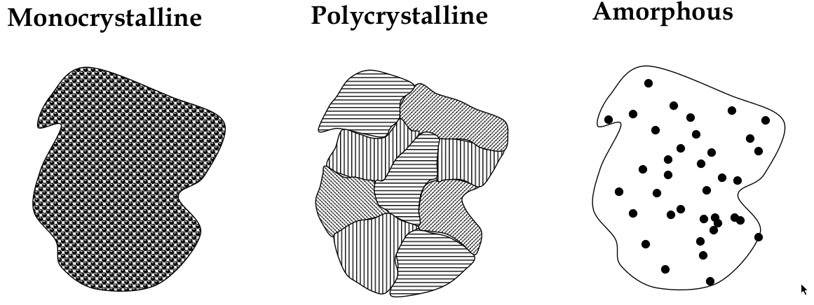
Types of material crystal structures
Single or Mono Crystalline Materials
Multi or Poly Crystalline Materials
Non Crystalline or Amorphous Materials

Slide 42
Miller Indices
The orientation of a surface or a crystal plane may be defined by considering how the plane (or indeed any parallel plane) intersects the main crystallographic axes of the solid.
The application of a set of rules leads to the assignment of the Miller Indices (hkl), which are a set of numbers which quantify the intercepts and thus may be used to uniquely identify the plane or surface.

Slide 43
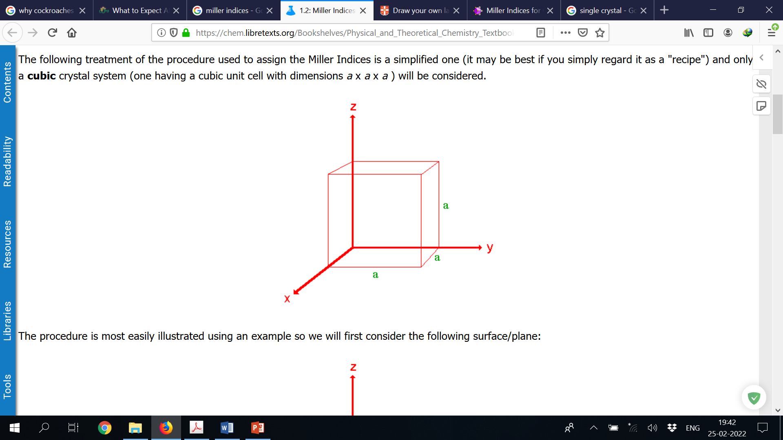
The following treatment of the procedure used to assign the Miller Indices is a simplified one and only a cubic crystal system (one having a cubic unit cell with dimensions a x a x a ) will be considered.

Slide 44
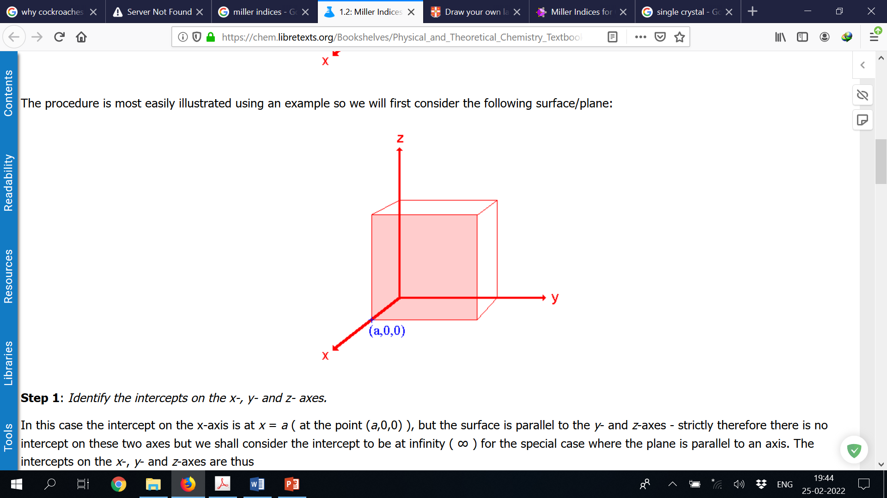
The procedure is most easily illustrated using an example so we will first consider the following surface/plane:
Intercepts: a, ∞, ∞

Slide 45
Co-ordinates are converted to fractional co-ordinates by dividing by the respective cell-dimension
For example, a point (x,y,z) in a unit cell of dimensions a x b x c has fractional co-ordinates of ( x/a, y/b, z/c ).
In the case of a cubic unit cell each co-ordinate will simply be divided by the cubic cell constant, a . This gives
Fractional Intercepts: a/a, ∞/a, ∞/a i.e. 1, ∞, ∞

Slide 46
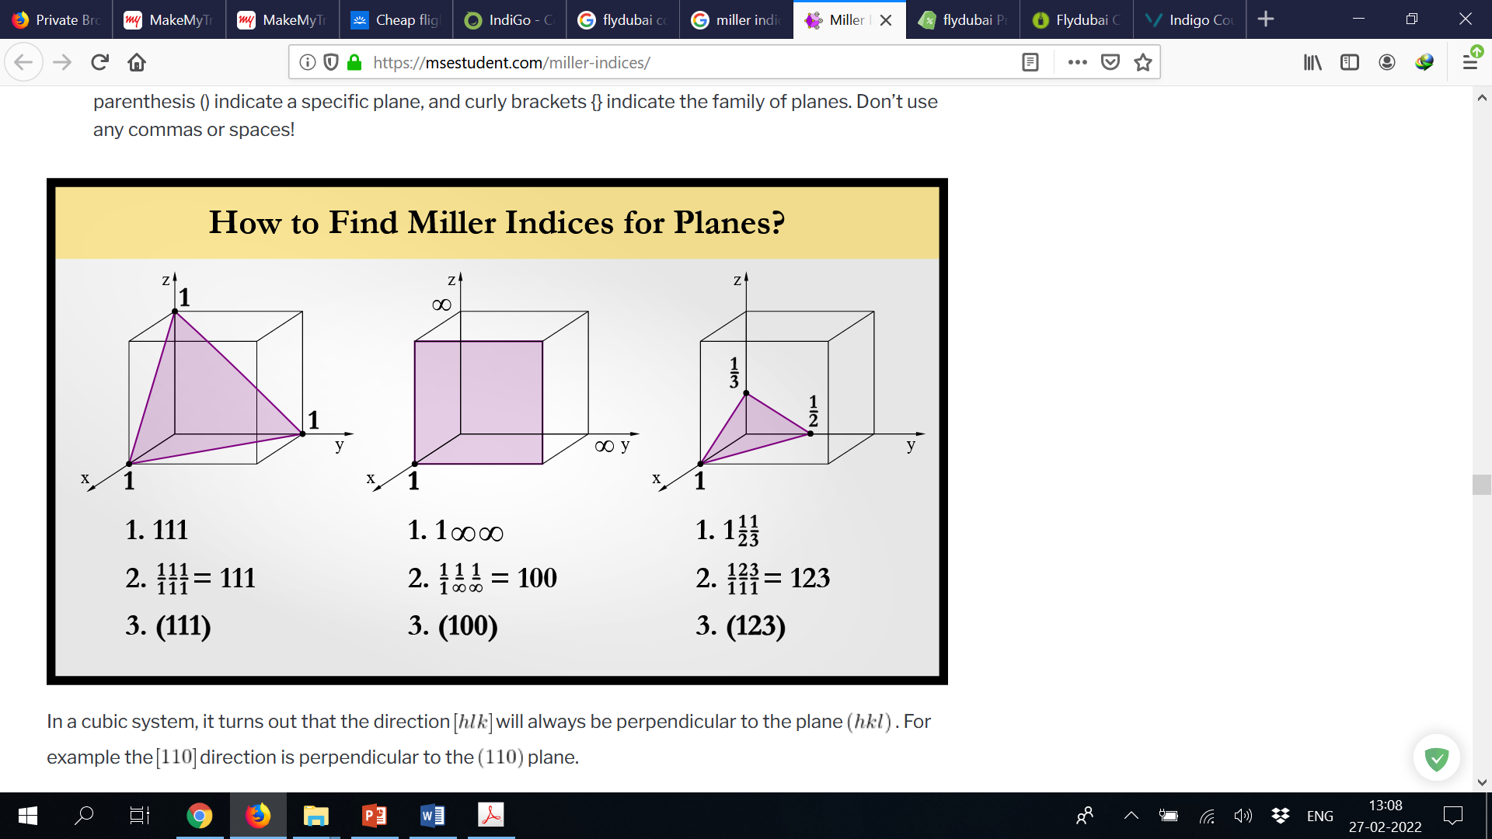
The reciprocals of 1 and ∞ are 1 and 0 respectively, thus yielding
Miller Indices: (100)
So the surface/plane illustrated is the (100) plane of the cubic crystal.

Slide 47

The distances between parallel planes in a crystal are designated as d_{hkl}.
For different cubic lattices these interplanar spacings are given by the general formula
$$d_{hkl}=\frac{a}{\sqrt{h^{2}+k^{2}+l^{2}}}$$
Where a is the length of the cube side while h, k and l are the Miller indices of the plane.

Slide 48
X-ray crystallography
X-ray Crystallography is a scientific method used to determine the arrangement of atoms of a crystalline solid in three dimensional space.
This technique takes advantage of the interatomic spacing of most crystalline solids by employing them as a diffraction gradient for x-ray light, which has wavelengths on the order of 1 angstrom (10⁻⁸ cm).
The structures of crystals and molecules are often being identified using x-ray diffraction studies, which are explained by Bragg’s Law.

Slide 49
Bragg’s Law
Bragg’s Law was introduced by Sir W.H. Bragg and his son Sir W.L. Bragg.
The law states that when the x-ray is incident onto a crystal surface, its angle of incidence, θ, will reflect back with a same angle of scattering, θ.
And, when the path difference, d is equal to a whole number, n, of wavelength, a constructive interference will occur.

Slide 50
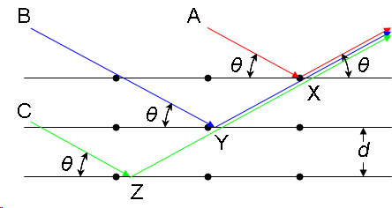
Consider a single crystal with aligned planes of lattice points separated by a distance d.
Monochromatic X-rays A, B, and C are incident upon the crystal at an angle θ. They reflect off atoms X, Y, or Z.
The path difference between the ray reflected at atom X and the ray reflected at atom Y can be seen to be 2YX.

Slide 51

From the Law of Sines we can express this distance YX in terms of the lattice distance and the X-ray incident angle:
$$2YX=2dsinθ$$
If the path difference is equal to an integer multiple of the wavelength, then X-rays A and B (and by extension C) will arrive at atom X in the same phase.
In other words, constructive interference will occur given the following conditions:
$$2YX=nλ$$

Slide 52

If, however, this condition is not satisfied, then destructive interference will occur.
On combining these equations, mathematically Bragg’s Law will be
$$nλ=2dsinθ$$
where:
λ is the wavelength of the x-ray,
d is the spacing of the crystal layers (path difference),
θ is the incident angle (the angle between incident ray and the scatter plane), and
n is an integer

Slide 53
For BCC iron, compute:
the interplanar spacing and
the diffraction angle
for the (220) set of planes. The lattice parameter for Fe is 0.2866 nm. Assume that monochromatic radiation having a wavelength of 0.1790 nm is used, and the order of reflection is 1.

Slide 54
Imperfection and defects
Thus far it has been tacitly assumed that perfect order exists throughout crystalline materials on an atomic scale.
However, such an idealized solid does not exist; all contain large numbers of various defects or imperfections.
Any irregularity in the pattern of crystal arrangement in a solid lattice is called imperfection in solids.

Slide 55
2. Line Defect
Edge dislocation
Screw Dislocation
Slip
Twinning
1. Point Defect
Stoichiometric Defects
Vacancy Defect
Interstitial Defect
Schottky Defect
Frenkel Defect
(b) Non Stoichiometric Defects
Metal Excess Defect
Metal Deficiency Defect

Slide 56
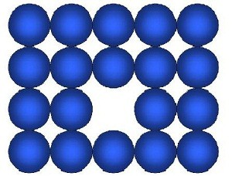
Vacancy Defect
Formation of vacancy defects take place due to vacant lattice sites.
This defect generally occurs when we heat a solid. Vacancy defect also decreases the density of solid.

Slide 57
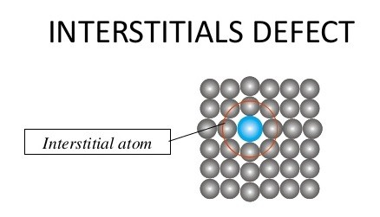
Interstitial Defect
When some extra constituent particles (atoms, molecules or ions) are acquainted in the interstitial sites, the solid lattice is said to have an interstitial defect.
Interstitial Defects are responsible for increasing density of the substance.

Slide 58
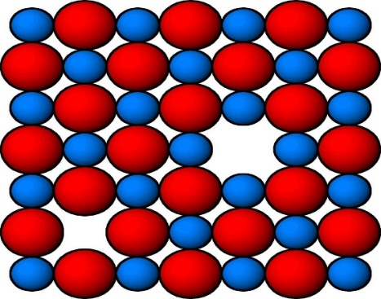
Schottky Defect
If in an ionic lattice equal number of cations and anions are missing from the lattice site, the lattice is said to have Schottky defect.
In Schottky Defect the electrical neutrality is maintained and it generally takes place in ionic solids. The compounds in which the size of cation and anion are nearly equal tend to show this type of defect.

Slide 59
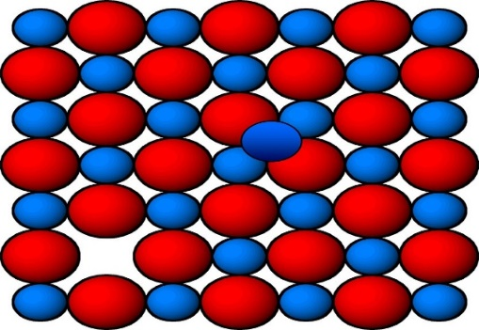
Frenkel Defect
Just like Schottky defect, Frenkel defect is also observed in ionic solids. When a smaller ion (generally cation) is moved from its normal position to a new interstitial site, Frenkel Defect occurs.
This dislocation of ion creates vacancy defect at its original site and interstitial defect at its new position. The density of the crystal lattice remains same in Frenkel Defect.

Slide 60
Metal Excess Defect
Metal Excess Defect occurs in two ways:
1. Due to anionic vacancies
Metal Excess Defect can be seen in alkali halides like NaCl and KCl. In this type of defect, the anionic vacancies are missing and are filled by an electron to ensure electrical neutrality.
2. Due to presence of extra cations at interstitial sites
In this type of defect, extra positive ions and electrons occupy interstitial sites and maintain electrical neutrality. In other words, this defect is losing non-metal atoms leaving their electrons behind and excess metal occupies interstitial positions.

Slide 61
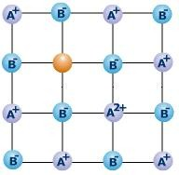
Metal Deficiency Defect
This defect occurs in metals containing less number of cations than anions. It is mostly seen in compounds depicting variable oxidation states.
Due to unequal number of cations and anions the metals obtained are non-stoichiometric. Some common examples falling under this category of defect are Fe_{0.95}O, Fe_{0.93}O etc.

Slide 62
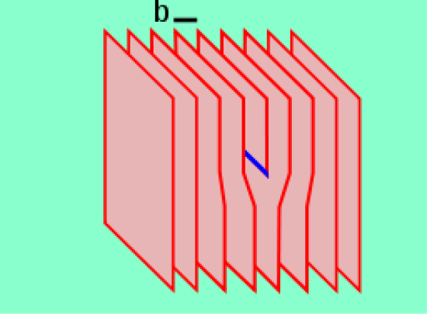
Edge Dislocation
Edge dislocation is a type of line defect in crystal lattices in which the defect occurs either due to the presence of an extra plane of atoms or due to the loss of a half of a plane of atoms in the middle of the lattice.
This defect causes the nearby planes of atoms to bend towards the dislocation. Therefore, the adjacent planes of atoms are not straight. The region in which the defect occurs is the dislocation core or area.

Slide 63
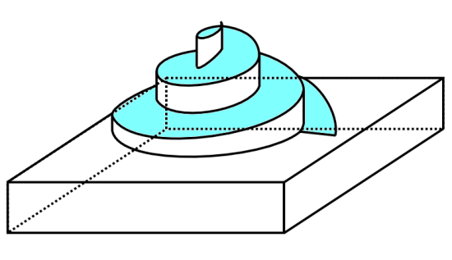
Screw Dislocation
Screw dislocation is another type of line defect in which the defect occurs when the planes of atoms in the crystal lattice trace a helical path around the dislocation line.
Unlike in edge dislocation, when we apply stress on a crystal having this defect, the dislocation area moves perpendicular to the direction of stress.

Slide 64
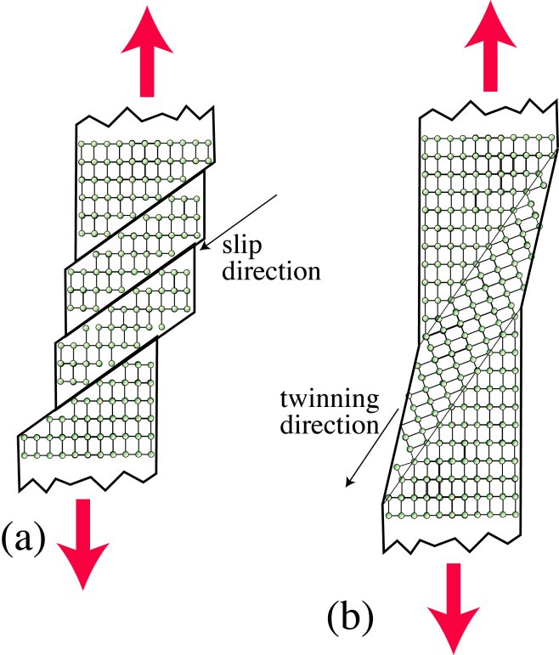
Slip
Slip is the large displacement of one part of a crystal relative to another part along the crystallographic planes and directions.
A slip can occur by the passage of dislocations on close-packed planes. These are the planes containing the greatest number of atoms per area and in close-packed directions.

Slide 65
Twinning
Crystal twinning is the event where two different crystals share some of the same crystal lattices that are pointing in a symmetric manner. The result of the twinning in a crystal lattice is an intergrowth of two separate crystals in a variety of specific configurations.
In this phenomenon, the surface along which the crystal lattice points are shared in a twinned crystal is known as “composition surface or twin plane”.

Slide 66
End of Module I Thank You

